Slide 1
Module 5 - Coding with Axon

Slide 2
Where Things Are

Slide 3
Storage on SkySpark Server
Determine location of SkySpark root directory.
For example: C:\SkySpark\skyspark-[version]
The var directory does not need to be stored inside root directory, but if it isn’t the –var <path> flag (used when starting up SkySpark) must be used when launching SkySpark to provide the full path to the var directory
Projects are stored in: var\proj
Folio database: var\proj\demo\db
History is stored in folio

Slide 4
Reminder of how to change the Heap Setting
SkySpark defaults to use approximately 25% of system memory
This allocation is called heap
Changing heap size: [SkySpark Root Dir]\etc\sys\config.props
Look for: // java.options=-Xmx512M (use Notepad++ or Vim)
Remove the // to take away the default and use the stated value
SkySpark will not load if set too high, but simply set lower and try again

Slide 5
Introduction to the Axon Language

Slide 6
Axon - General Purpose Programming Language
Simple: Minimal language syntax
Functional: Everything is a function
Dynamically typed: values, not variables have types
Tag Oriented: Works in conjunction with the Folio database tag model and Project Haystack
Component Oriented: Specialized syntax to create software components (specifically used with rules)
Time-Series Oriented: Rich library of functions for time-series data analytics
Unit Oriented: Numbers intrinsically have units of measurement
Axon Overview: https://skyfoundry.com/doc/docSkySpark/Axon

Slide 7
Databases
SkySpark’s Folio database is a key to its speed and small size
There are many different types of databases and throughout this course we mostly compare Folio’s graph-oriented NoSQL database to SQL databases
The basic unit of storage in Folio is a record (like a row in Excel)
Folio stores site, equip, point, and his records (among other things)
Facts are added to these records as tags
Ordering data (records) can be very expensive in databases, so records are not usually ordered
SkySpark will always order history records from a hisRead() using the timestamp
The four database operations are Create, Read, Update, and Delete aka CRUD

Slide 8
Data Types (Kinds)
Bool – true/false
Str – “Character #42”
Uri - `http://www.skyfoundry.com`
Date – 2020-01-31
Time – 21:30:00
Marker – point/equip/site/etc. – tag has no value other than its name
Ref - @p:demo:r:1cd13a0e-af936d63 - link to another record in Folio
Number – 200ft – supports math functions and has a unit
Bin – essentially file storage in Folio
DateTime – dateTime(2020-01-31,21:30:00)
Coord – coord(37.55, -77.55)
Supported Scalar Literals: https://skyfoundry.com/doc/docSkySpark/AxonLang#scalars

Slide 9

Axon Shell
Accessed via the Tools app Shell view
Used for testing Axon
Also a great tool for understanding what is in Folio when starting on a new project
Where we run “one-liners”
Shell

Slide 10
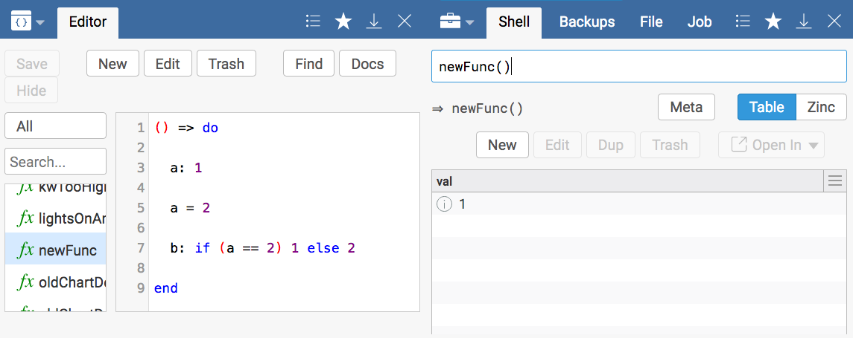
Variables
Variables are a programmatic way of storing a value
The colon : declares / dimensionalizes the variable and sets its initial value all in one step
The equals = operator reassigns the variable’s value
Note that a variable can have an if statement or a loop or virtually anything inside its declaration or reassignment
Valid to assign a variable a number and then later a string because axon variables do not have declared types, but this is not best practice

Slide 11
Functions and Invocation
Functions take one or more parameters as inputs then return a result
isOdd(3) - returns true
contains(“axon is fun”, “fun”) - returns true
The order and data type of function parameters is important.
Function call operator () is used to invoke a function.
Dot operator passes the value (or function result) as the first parameter to a function (note the first parameter can be before or after the function)
3.isOdd - returns true
“axon is fun”.contains(“fun”) - returns true
When using the Dot operator, the function call operator () isn’t always required, but can still be used: 3.isOdd()

Slide 12
Axon: Operators
Math operators: +, -, *, /
Unit math and conversions: as(), to()
Comparison operators: ==, !=, <, <=, >=, >, <=>
Boolean operators: and, or, not
Function call () operator
Function call . operator (Dot)
Get []
Trap -> operator
Define : operator
Reassign = operator

Slide 13
Axon: Flow Control Expressions
do..end and defcomp..end expressions
code block like { } in C languages
return expression
if / else if / else expression
try / catch expression
throw expression
Lambda Function Definition =>

Slide 14

More Axon Concepts
Functions can take other functions
Transformations - usually have Map in the name
Filtering functions - usually have Find in the name
Fold/Rollup
Loops
In functions, the last line is what is returned
Not required to explicitly use return
Single entry and exit points (code starts in one place and ends in one place)
Transformations

Slide 15
Axon Language: Commenting Code
Axon has two types of comments (// and /*..*/):
// Comments out a single line
/*
Comments out until end symbol
Blah Blah Blah
*/
Use comments to explain code – commented code does not execute
Use comments when debugging code - uncomment code a line at a time to get it to work

Slide 16
Axon Collections

Slide 17

Collection Data Structures in SkySpark
Collections are used to store more than one “thing” in a variable
List - []
Dict (Dictionary) - {}
Grid - [].toGrid
Special case - List of Dicts (looks like and may convert to Grid)
Collections

Slide 18
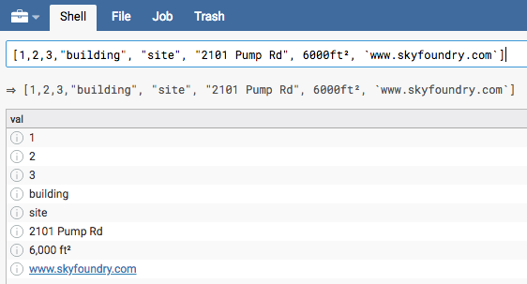
What is a List?
A List stores a linear sequence of objects zero indexed by an integer
Think of a List as a column
Order matters
Cannot name single column
Access values by position (index).
[1,2,3,"building", "site", "2101 Pump Rd", 6000ft², `www.skyfoundry.com`]
More List Examples: https://skyfoundry.com/doc/docSkySpark/AxonUsage#list

Slide 19
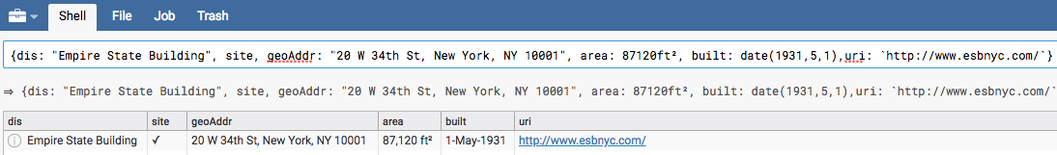
What is a Dict?
A Dict stores key/value pairs. Think of each key as a tag. A Dict is a row.
Any quoted string can be a key, but typically keys follow the syntax rules of a tag
Keys with no value have a special “marker” value
Access values by their key
{dis: "Empire State Building", site, geoAddr: "20 W 34th St, New York, NY 10001", area: 87120ft², built: date(1931,5,1),uri: `http://www.esbnyc.com/`}
More Dict Examples: https://skyfoundry.com/doc/docSkySpark/AxonUsage#dict

Slide 20
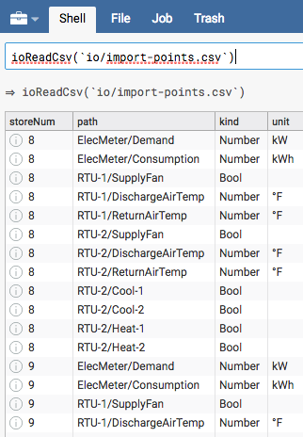
What is a Grid?
A Grid is a two-dimensional data structure (rows and columns) commonly used when analyzing data in SkySpark
We start with a grid and then do any filtering / transformations we want
Each row is a Dict
Common things in grids
Imports will generally be in grids
History data
Special kinds of Grids are HisGrid, HisDurGrid…etc
More Grid Examples: https://skyfoundry.com/doc/docSkySpark/AxonUsage#grid

Slide 21
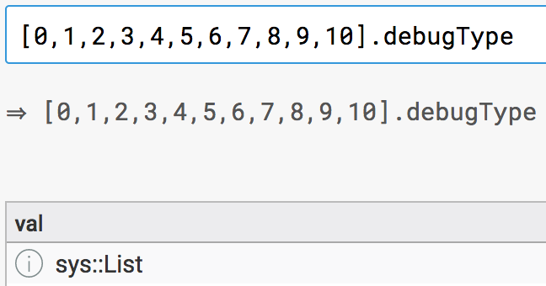
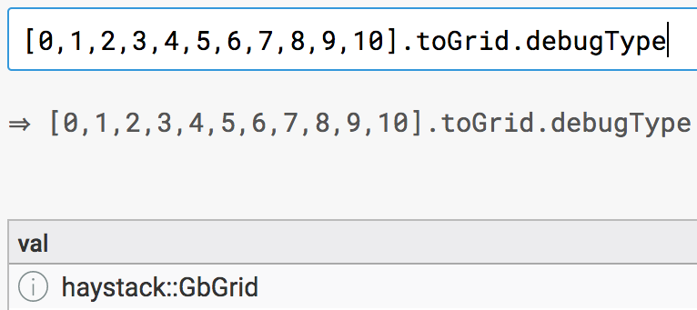
Checking Data Structure Types
Useful function: debugType()

Slide 22
Reading Records from Folio

Slide 23
Reading Records from Folio using Tags
point - Returns all records with the point tag
Order is Random
Cannot use Dot operator to pass results to another function
Convenience for use in the Axon Shell
read(point) - Returns 1 random record with the point tag
Returns dictionary or error
Works with Dot operator
readAll(point) - Returns all records with the point tag
Always returns grid
Order is Random
Works with Dot operator
readCount(equip) - Returns the number of records that have the equip tag

Slide 24

Reading Records from Folio using References
readById(@id) - Read record via reference
Column order not preserved
readByIds([@id1, @id2]) - Read multiple records formatted as a list
readLink(@id) – Returns a Grid with columns ordered
Slower than readById()
Reading

Slide 25
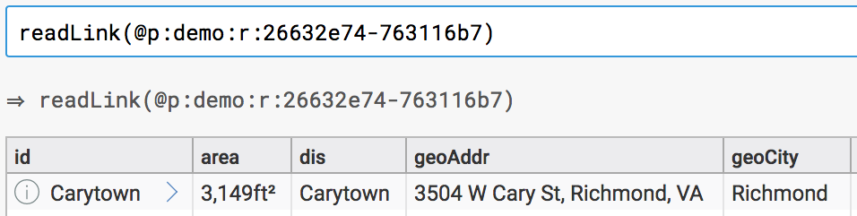
Quick Way to Access Reference to a Record
In the Demo project, open the Tools app and Shell view
Type this: read(site)
Click the > icon in the id column
Press up on the keyboard to place the command in the Shell (note previous commands are cached and can be accessed this way)
Use the Dot operator to pass this record to another function
Useful for testing
4
3

Slide 26
Reading Records and Sorting
Databases generally will not order results unless explicitly requested
readAll(site).sortDis – Return all records with a site tag and sort via display name
readAll(point).sort(“hisEnd”) – Return all records with a point tag and sort via the value of each records hisEnd tag
readAll(point).sortr(“hisEnd”) – Return all records with a point tag and sort via the value of each records hisEnd tag in reverse order

Slide 27
Reading Records Unchecked
By default, the read() functions will check that a record exists and throw an unknown rec error if no records are found
The read() functions can take a second parameter that is a Bool value to disable the check
read(fakePoint, false) – Will return null instead of an unknown rec error when no records with the fakePoint tag are found

Slide 28
Reading History Records

Slide 29

The hisRead Function and Axon Dates
read(point).hisRead(today)
hisRead() is one of the most important functions in Axon as SkySpark typically needs to read history
hisRead() can take relative dates, real dates, and ranges
pastWeek, pastMonth, pastYear
lastWeek, lastMonth, lastYear
thisWeek, thisMonth, thisYear
yesterday, today
2014-09-09
2014-09-22..2014-10-12
null (all history for that point up to limit of 10,000)
Documentation for hisRead(): https://skyfoundry.com/doc/ext-his/funcs#hisRead

Slide 30
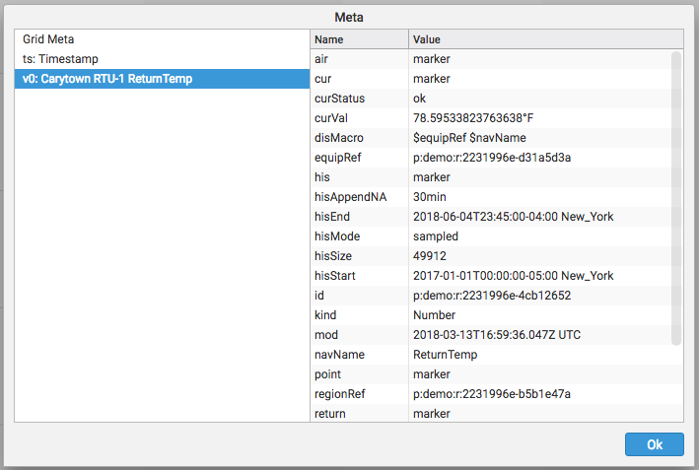
hisRead part 2
When writing functions, the programmatic name of the timestamp column is ts, the first history column is v0, the second is v1 and so on…
The order of the columns must be guaranteed for this to work

Slide 31
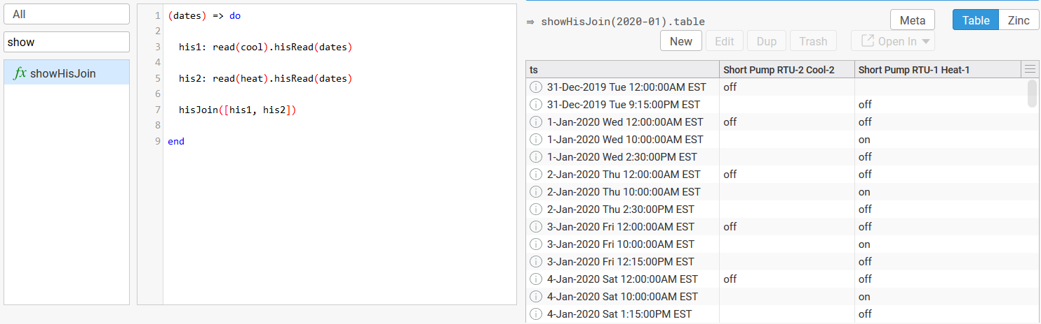
The hisJoin Function
Takes a list of histories and joins them by timestamp (ts)
Note the [] – hisJoin() takes a list of HisGrids
hisPeriodIntersection([per1, per2])
hisRead([pt1, pt2], dates) – Order of the list is preserved as pt will always be v0 and pt2 will always be v1, etc
hisJoin([his1, his2]) – Order of the list is preserved as his1 will always be v0 and his2 will always be v1

Slide 32
Usage of Key Operators and Functions in Axon

Slide 33
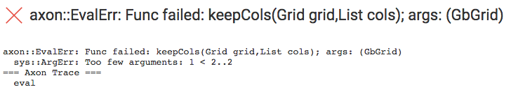
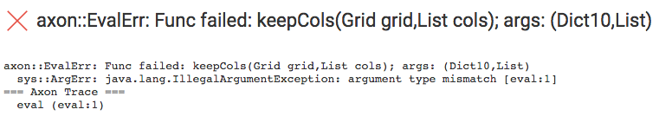
Pay Attention to Number of and Type of Parameters
Error says keepCols takes 2 arguments, but only 1 was provided
What does this error say?
Read the top lines:
1
2

Slide 34
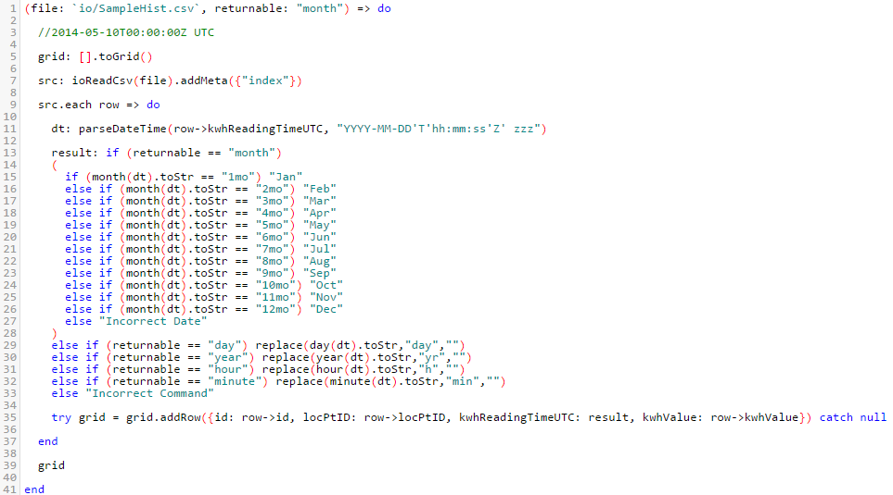
Using an if statement part 1
if statements control flow
if (condition) result
if (x==y) z=1
No end
else if evaluates in order when if not met
else happens when no other conditions met
if statements can be nested
Note that the condition evaluates as true or false

Slide 35
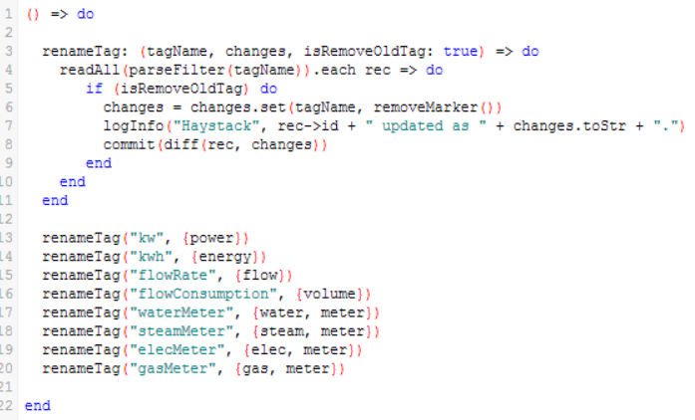
Using an if statement part 2
if statements can have multiple lines
The results are between a do and end
Note that this function will also convert Haystack pre-2.0.5 compliant tags to 2.0.5

Slide 36
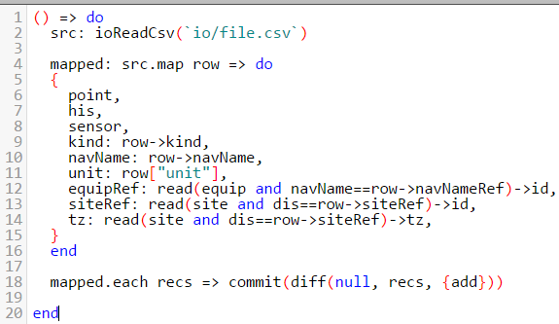
Using a loop
Note: Be careful using loops as they consume lots of processing resources
Sometimes iterations are needed, such as when using formulas or importing data:
grid.each row => do … end
For each thing, do something
grid.map row => do {} end
For each dict in my grid, return a new dict that looks some way.
Replaces each()..addRow() syntax – way more efficient
Must return a dict as stated
Accumulators
acc: 0; acc = acc + 1
Used for very special cases
Tracking an aggregate number:
Sum
Average
Count
Variable name (row) does not matter. Note the loop in the declaration.
Use map() for many imports and calculations in rules

Slide 37
Using the Trap Operator
Accessing the value of a tag on a record
The Trap Operator -> only works on a Dict
The Trap Operator -> is used on virtually all rules
Records store information in the form of tags
The Trap Operator is how we retrieve that data
{dis: “Building 1”} -> dis == “Building 1”
read(site and tz == “New_York”)->tz == “New_York”

Slide 38
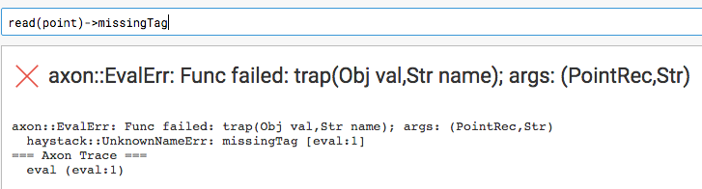
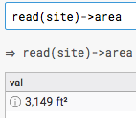
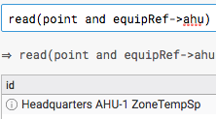
Using the Trap Operator part 2
Access the value of the area tag on a site record
Error when trying to access the value of a tag that does not exist on the record
Equivalent of simultaneous SQL Left Join and Where filter; also called filtering on a foreign record or filtering on a record in another table (SkySpark does not use tables)
2
1
3

Slide 39
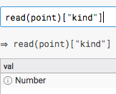
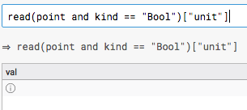
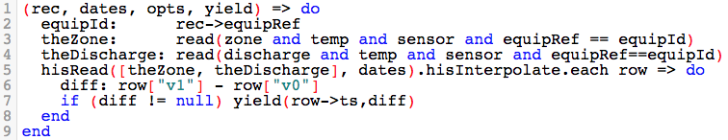
Using the Get Operator
The symbols [] are called get and require the tag name to be in quotes while -> (trap) does not
The [] (get) operator will return null rather than error if the tag does not exist on the record
Note the v0 and v1 we discussed earlier
1
2
3

Slide 40
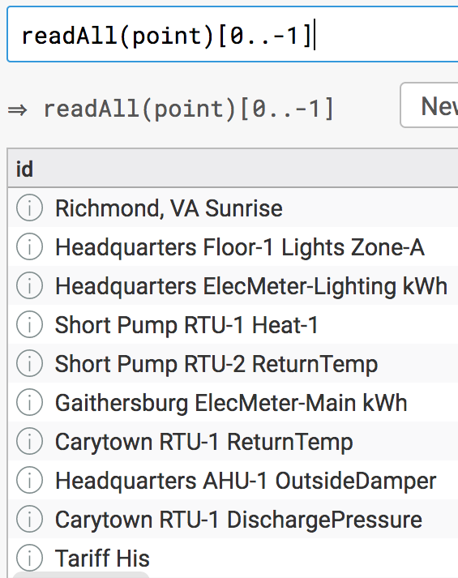
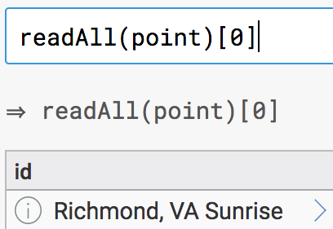
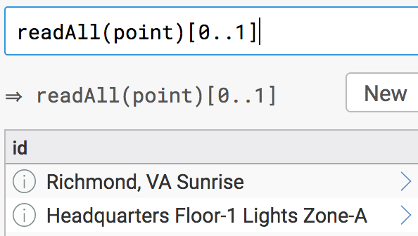
Positional Indexing
Use the index operator [] to access a single value or range of values from a collection
The Str, List, and Grid datatypes allow for indexing
Indices are zero-based and -1 references the end
Error when out of bounds

Slide 41
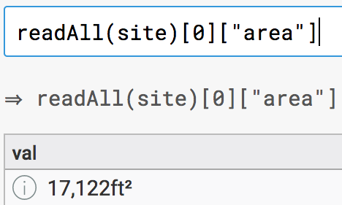
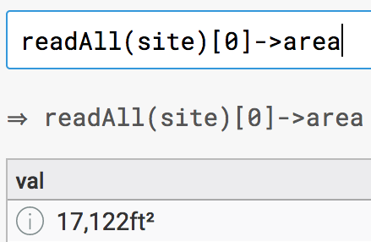
Using Trap and Get Operators with Indexing
Since [0..-1] is everything, [1..-2] cuts out first and last – useful for files
Can use 2 gets or a get and a trap to denote a record and tag simultaneously (functional programming)
Note how functional programming allows the output of one function to be the input of the next function
Try readAll(point).getSafe(0..999)
It does not error when the index is out of bounds
Like TOP or LIMIT in SQL

Slide 42
Lambdas

Slide 43
What is a Lambda?
Lambdas are anonymous (unnamed) functions within other functions
SkySpark uses Lambdas, denoted by =>, to concisely express data filtering or data transformation functions
Generally, a function with Find in the name means filter and a function with Map in the name means transform
In SkySpark, Lambdas are technically Closures because they enclose the scope of where they are defined
The name of the variable does not matter as long as the left and right sides are consistent, but as a best practice choose something that won’t get confused with an existing variable

Slide 44
Examples using a lambda
Think of it as saying, variable => goes to or where
<HisGrid>.hisFindPeriods(x => x == false)
<Grid>.map row => do {geoCity: row->city, geoState: row->state} end
<HisGrid>.hisMap(x => if (x == 1) true else false)
<List>.any(val => val.isOdd)
<List>.all(val => val.isOdd)
<Grid>.each row => do … end
<Grid>.find(row => row -> area > 10000)
<Grid>.findAll(row => row -> area > 10000)
<Grid>.addCol(“axId”, row => row -> id)
<HisDurGrid>.hisFindAll(x => x > 30min)

Slide 45
Popular Functions that accept Lambdas
hisMap() – take each value at a cell level and return what is directed
New dataset must have the same number of rows as old dataset even if some are null – works on all none ts columns of a HisGrid
map() – take each row of Grid and return the new dictionary as directed
New dataset can have different number of rows if null is returned
hisFindAll() – take each value at a cell level and filter out values based on function returning true or false – only for HisGrids
New dataset size will be <= the size of the old dataset
findAll() – take each row and filter out rows by evaluating function that returns true or false – works at the row level of any Grid
New dataset size will be <= the size of the old dataset
hisFindPeriods() – take each value at a cell level and return durations based on function – only works on HisGrids
New dataset size will be <= the size of the old dataset

Slide 46
Lambda Tricks (optional)
Shorthand for true and false
<HisGrid>.hisFindPeriods(x => not x) - not x equivalent to x==false
<HisGrid>.hisFindPeriods(x => x) - x equivalent to x==true
Use map() as a filter
<HisGrid>.map r => if (r->v0 > 140) null else r
Comparison operators behave like an implicit if to return true/false or any of -1, 0, and 1
<HisGrid>.hisMap(x => x == 1) - same as if (x == 1) true else false
<HisGrid>.hisMap(x => x <=> false) - same as if (x == false) 0 else 1

Slide 47
Code App

Slide 48
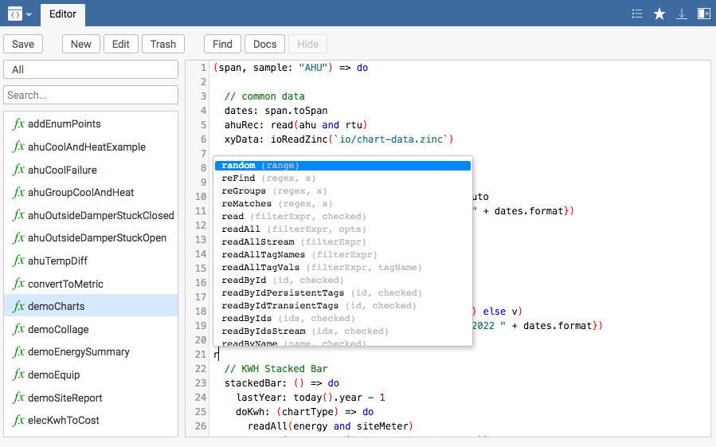

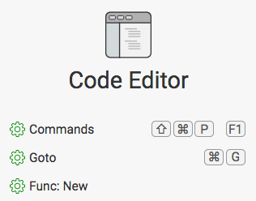
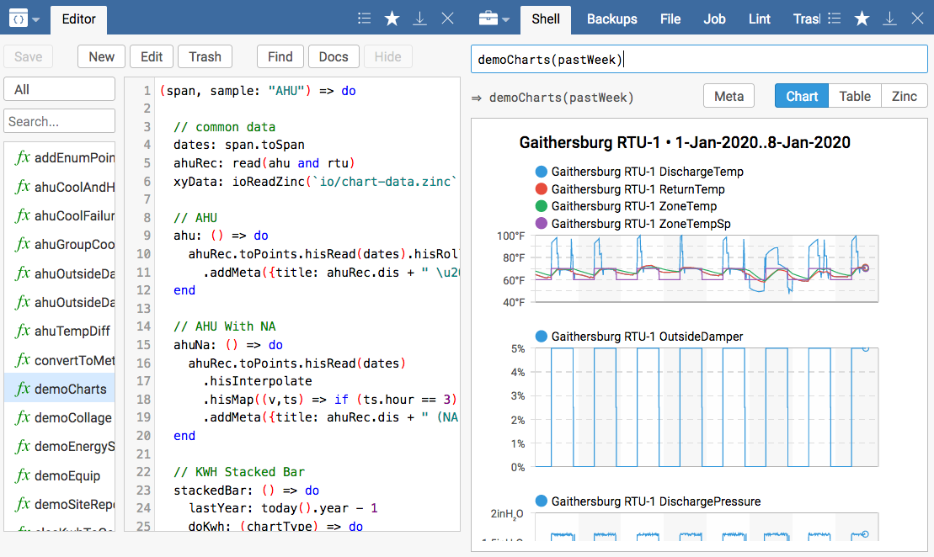

The Code App part 1
Code
The Code App is SkySpark’s IDE (Integrated Development Environment)
Note that the Commands, Goto, and Func: New items on the Code App’s home screen are shortcuts
Control + space brings up the auto-complete menu to quickly find functions and view their arguments
The split view button (top right corner), opens a second window to view a different app or view side by side, such as the Tools App (helpful for testing functions)

Slide 49
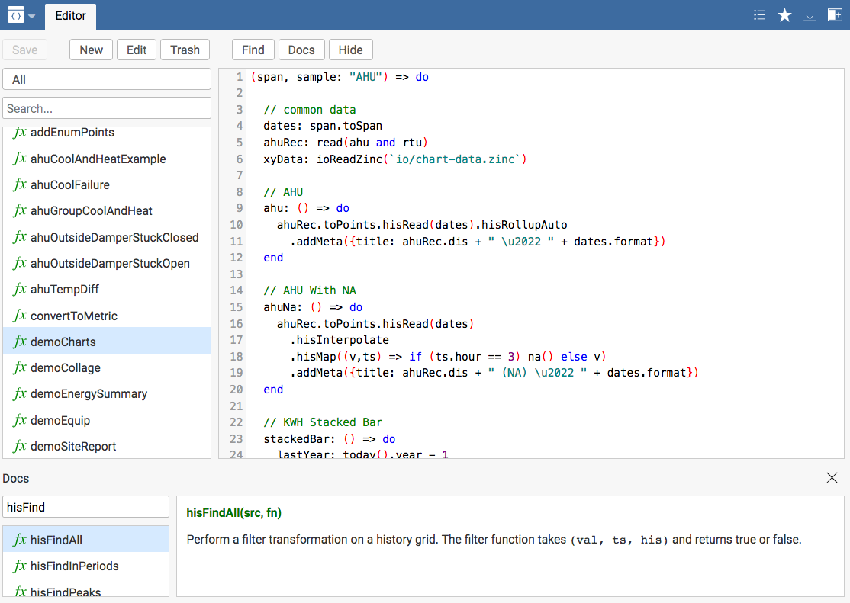
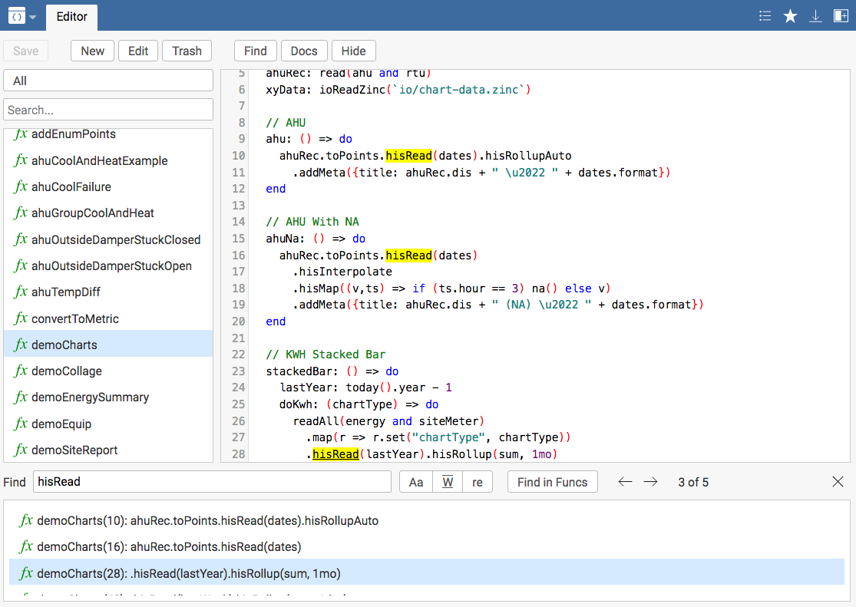
The Code App part 2
Code
You can search for available functions with Docs: very important, teach yourself code with this
You can search your functions for specific strings with Find
Control + S will do a save
F1 shows you available shortcuts
F5 is handy as it will refresh a screen
Control (Command on Mac) + U gives you the unit picker
Clicking on the tab Editor returns you to the app’s home screen
Code App Training Video: https://www.skyfoundry.com/doc/docTraining/CodeEditor

Slide 50
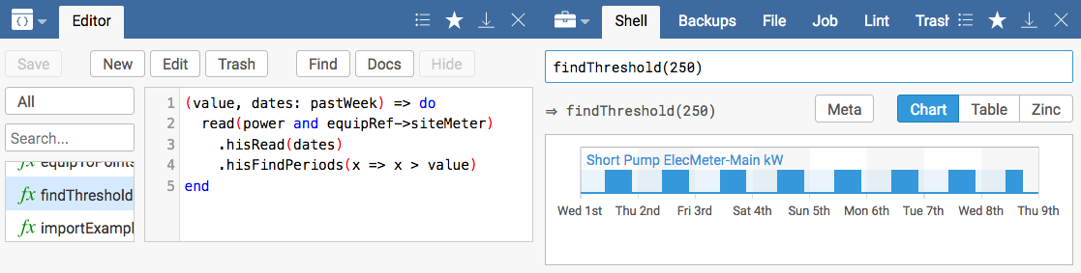
Lambda/Closure Exercise
Use case: Create a function that will define a threshold value for demand and finds periods of time when the demand is above that threshold in the pastWeek
Create a new function called findThreshold in the Code App
Copy the following text into the function:
(value, dates: pastWeek) => do
read(power and equipRef->siteMeter)
.hisRead(dates)
.hisFindPeriods(x => x > value)
end
Run the threshold function in the Tools app to find periods of time
when the power usage was above 250 and then again for 350:

Slide 51
Folding and Rolling up Historical Data

Slide 52
Folding Functions
Axon has folding functions which compute single values from a collection of inputs. These are like aggregates in SQL.
<List>.fold(avg)
<Grid>.foldCol(“v0”,avg)
<Grid>.foldCols([“a”,”b”], “ab”, sum)
<HisGrid>.hisFoldCols(avg)
NOTE: fold and foldCol work on single columns while foldCols and hisFoldCols work on rows
Folding functions have a foldOn tag
Folding functions can perform any of the following operations:
avg ● mean ● min ● standardDeviation
count ● meanBiasErr ● rootMeanSquareErr ● sum
max ● median ● spread

Slide 53
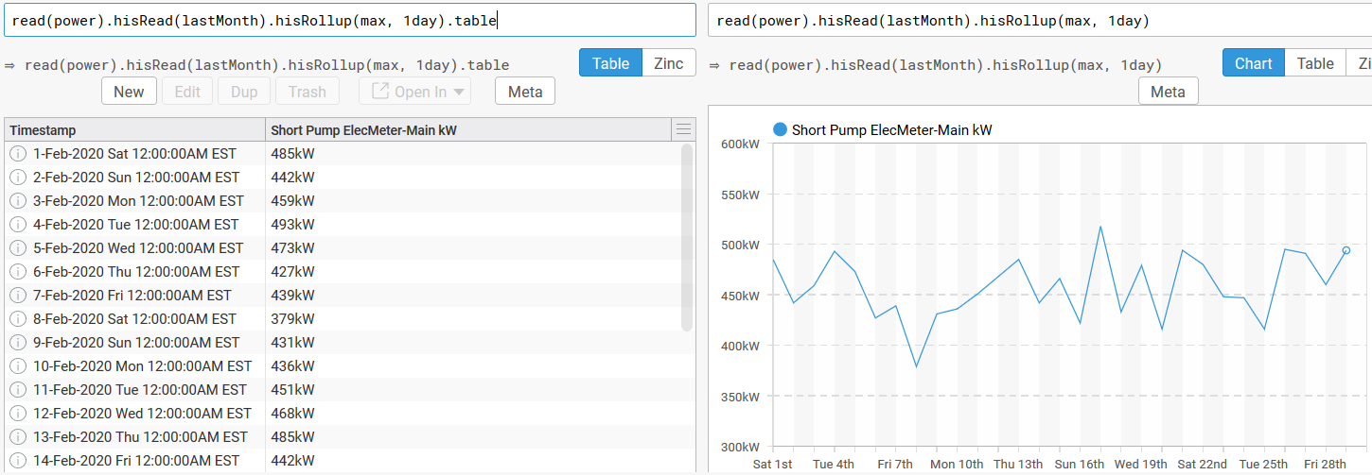
Rollups
Rollups take a history grid and a designated rollup function on each time interval:
<HisGrid>.hisRollup(max,1day)
<HisGrid>.hisRollupAuto - auto pick interval and function
Rollup functions can perform any of the following operations:
All the operations of a folding function
covAvg
discreteEnumPeriods
discretePeriods
durTrue

Slide 54

Exercise in the Code App Homework during Webcasts
Create a function that returns a Dict with the min, max, and avg of Headquarter’s siteMeter’s power point in the demo project for lastMonth
Remember that the last line of the function is what is returned
Extra Credit - Only do a single hisRead in the function
Extra Extra Credit
Update the function to take an argument for site’s dis and include the dis in the dictionary as a 4th key/value pair
Give the dis argument a default value
Exercise

Slide 55
Historical Data Transformations and Interpolation

Slide 56
Basic History Transform Functions Overview
hisRollup – decrease dataset
hisMap – change dataset
hisFindAll – filter dataset
hisFindPeriods – filter dataset and convert to time and durations
hisFoldCols – turn multiple histories into one
hisJoin – look at multiple histories
hisPeriodIntersection / hisPeriodUnion – find when multiple things or anything is happening

Slide 57
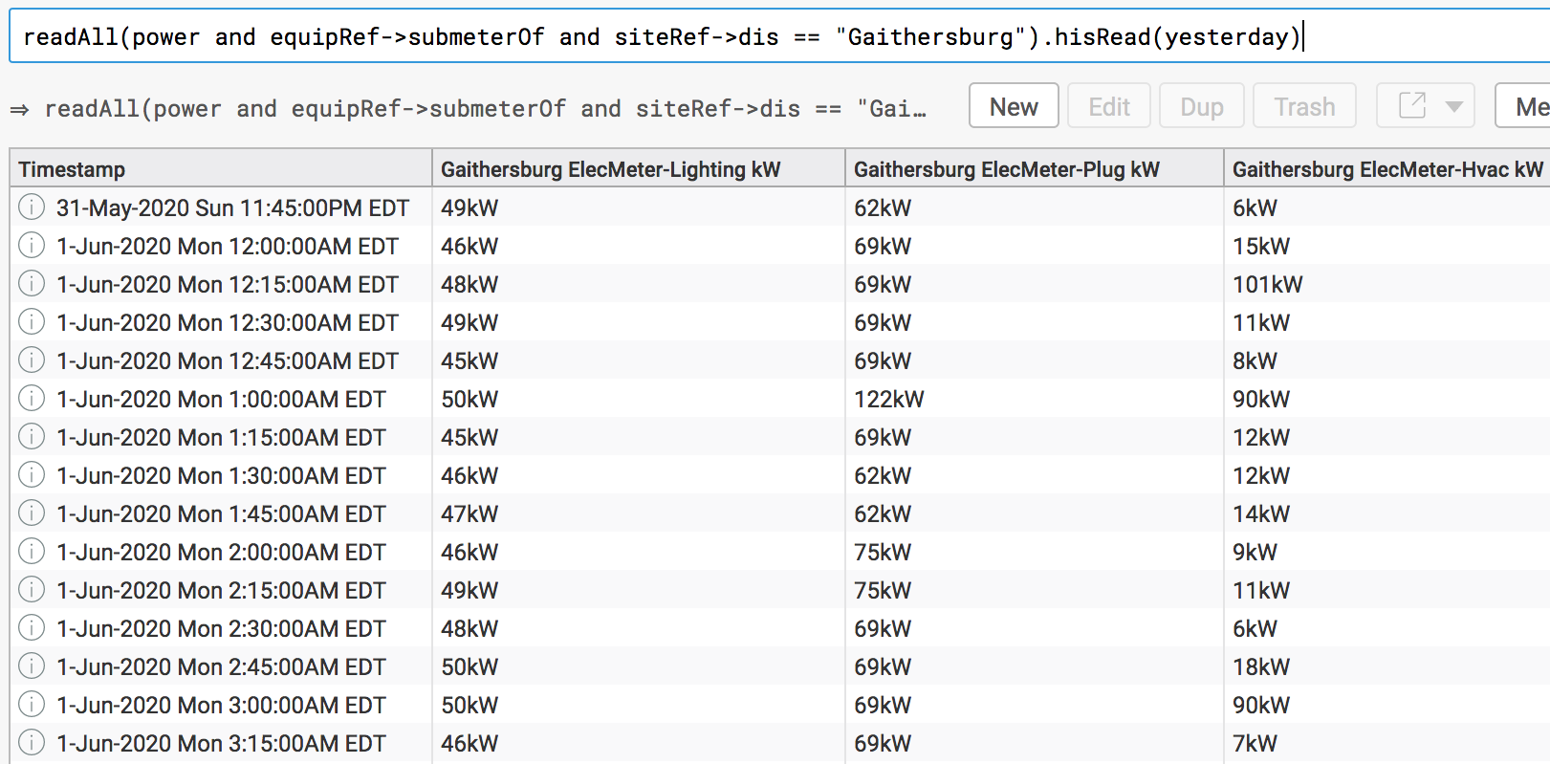
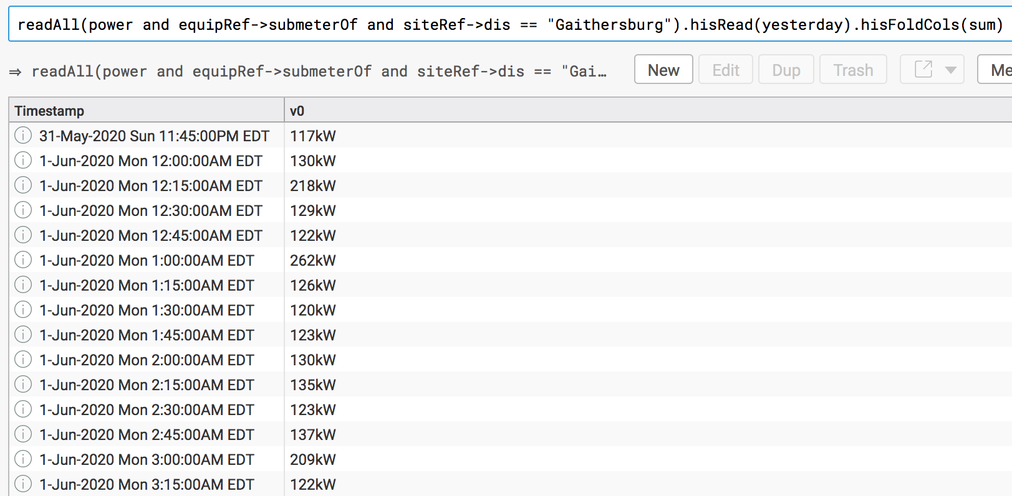
Time to talk about his functions:
There are certain functions that work on all non-ts columns (no matter how many) when you put a his in front of their name. Here are some examples:
<HisGrid>.hisMap(x => if (x) 1 else 0)
<HisGrid>.hisFindPeriods(val => val > 10)
<HisGrid>.hisFoldCols(max)

Slide 58
Interpolation part 1
History data is not usually perfectly aligned across data points
Different collection intervals
Change of Value
Connectivity issues cause gaps
Interpolation allows you to align multiple data points by estimating values between two known values
The function in Axon is hisInterpolate() which is used on history grids with multiple points
Before:
 | Zone Temp Sensor | AHU Cool 1
6/27/14 12:00 AM | 76.2°F | on
6/27/14 12:10 AM | 74.1°F
6/27/14 12:15 AM |  | off
6/27/14 12:20 AM | 73.3°F
6/27/14 12:30 AM | 72.1°F | on
After:
 | Zone Temp Sensor | AHU Cool 1
6/27/14 12:00 AM | 76.2°F | on
6/27/14 12:10 AM | 74.1°F | on
6/27/14 12:15 AM | 73.7°F | off
6/27/14 12:20 AM | 73.3°F | off
6/27/14 12:30 AM | 72.1°F | on
Documentation for Interpolation: https://skyfoundry.com/doc/ext-hisKit/doc#interpolation

Slide 59
Interpolation part 2
Three types of interpolation configured via the hisMode tag:
Sampled - Estimates missing values by plotting a straight line between known points. This is more common for sensors and Numbers.
Consumption – Similar to sampled, but the ts represents the end of the interval
Change of value (cov) - means the point has a static value until it changes. This is more common for commands and Booleans. Best practice is to force cov data to log every 24 hours to detect a faulty sensor.
Implementer must know the data
Best practice is to use hisInterpolate() when reading more than one history
readAll(temp).hisRead(pastWeek).hisInterpolate
hisRead([temp1,temp2], pastMonth).hisInterpolate
Note: Interpolating instantaneous kWh or duration values can be misleading because you might fill in values that do not exist
Documentation for hisMode: https://skyfoundry.com/doc/ext-his/tags#hisMode

Slide 60
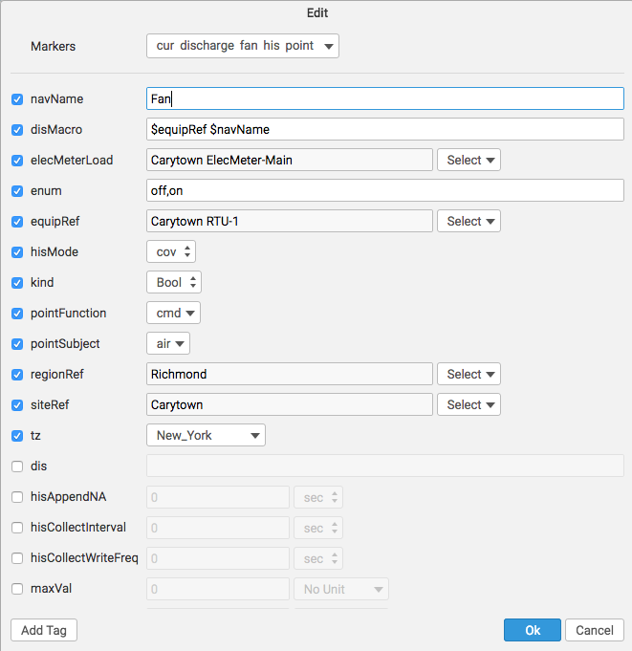
Interpolation part 3
The tag is hisMode and is applied to points to force something other than the default behavior (cov, sampled, or consumption)
Forcing 0 and 1s which should really be false and true into COV

Slide 61
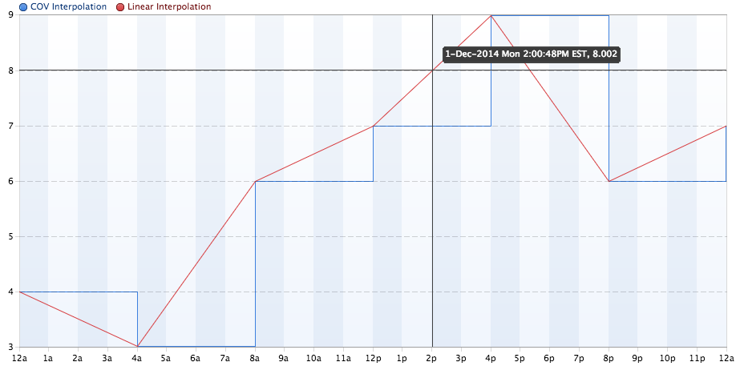
Interpolation part 4
{hisMode: sampled} versus {hisMode: cov}

Slide 62
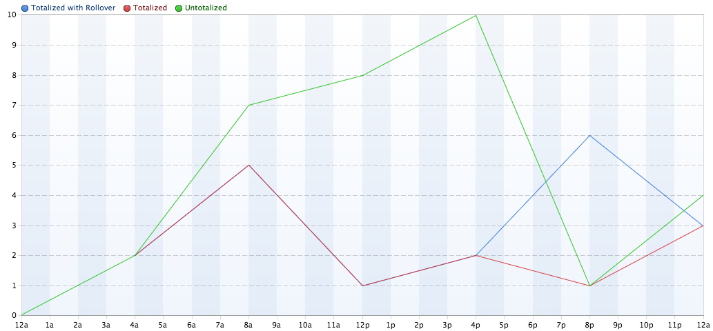
Interpolation part 5: Tags
dis: “Untotalized”
dis: “Totalized” hisTotalized
dis: “With Rollover” hisTotalized hisTotalizedRollover: 15

Slide 63
Interpolation and hisClip
The hisRead function will return an additional history record before and after the requested date range
Also included is 12am (if it exists) because it is a bad boundary condition
15 minute data over a day would normally be 96 samples, but the boundary conditions make it 99 samples; use hisClip to make it 96 samples again
The hisClip function will remove the additional history records
read(point).hisRead(lastWeek).hisClip
That could be problematic when using interpolation
Everything but sparkRules needs a hisClip
Always interpolate before using a hisClip because you want the best possible boundary conditions for your interpolation

Slide 64
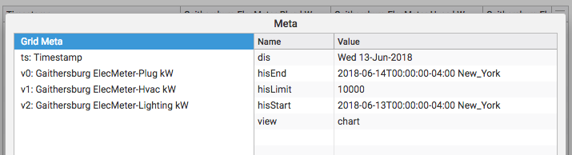
Built-in Limit of 10,000 Records for Queries
SkySpark caps the number of records generated by a query (check the hisLimit tag in HisGrid meta)
There are a couple reasons that a graph will not display history data for the entire requested data range
Small history collection interval ● Large data range
To remove or change the limit, pass an option as a Dict to the hisRead() function
read(point).hisRead(null, {-limit}) ● hisRead([pt1, pt2], dates, {limit:50000})
You must use a -limit before doing a rollup.
Example: read(point).hisRead(pastYear, {-limit}).hisRollup(max, 1day) in order for the
rollup to be passed the entire history grid.

Slide 65
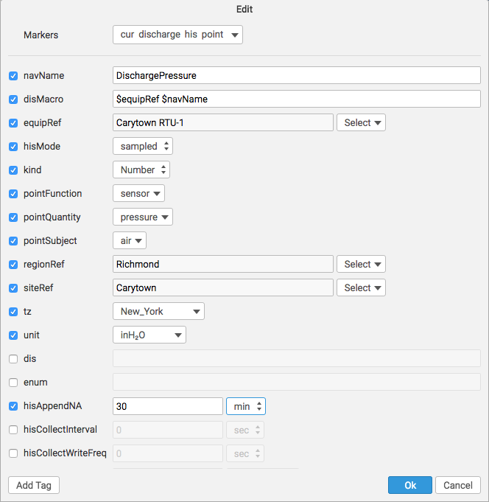
hisAppendNA
Sometimes data stops coming in
SkySpark’s default behavior is interpolate the last known data point into the future
A tag called hisAppendNA can be added to any point to prevent this behavior from happening
If you expect data to come in every 15min, then it might be wise to give the hisAppendNA tag a value of at least 2 intervals such as 30min as shown below
This will prevent false sparks
We put {hisAppendNA:30min} in our computed histories

Slide 66
Computed Histories

Slide 67
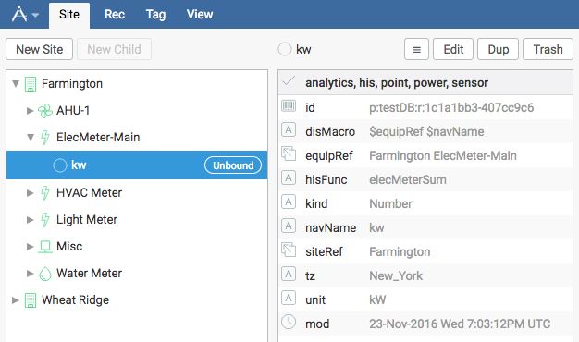
What is a Computed History? Part I
The name of this function is bound to the hisFunc tag of the point
Best practice is to include the {-limit, hisAppendNA: xxmin} on all computed histories’ hisReads
Say you have all meters, but the main meter?
Virtual point/computed histories take 4 parameters:
rec: the record the hisFunc is on
This is the starting point for ref jumping
dates: dateTime range (computed daily for rules)
opts: not used (legacy placeholder)
yield: used to control output
Computed History is not stored
Points count in license

Slide 68
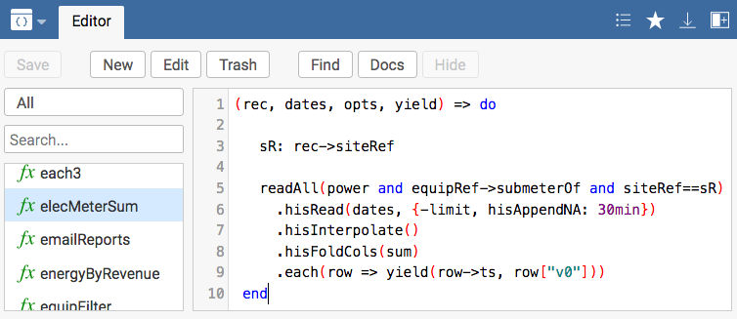
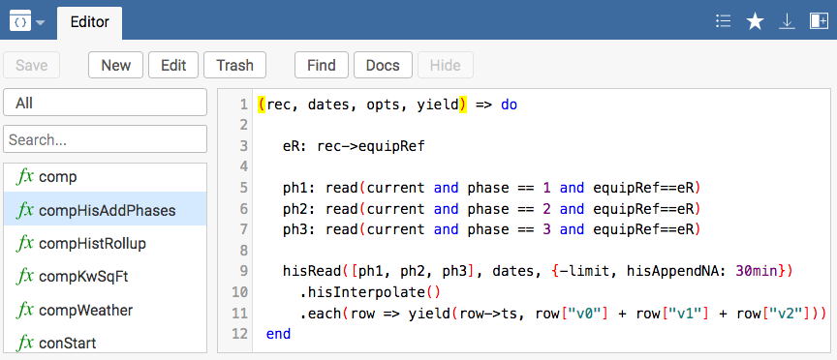
What is a Computed History? Part II
Examples:
Below: Note how you can insert virtually any formula after the yield once you have the necessary fields
Note the use of hisInterpolate and {-limit}
Also note that hisAppendNA is used to prevent old data from interpolating into the future when no more data is present
Note the hisRead
Note using each to loop through and create new history (will create same number of ts/val pairs as source grid)
Testing: read(point).hisRead(yesterday)

Slide 69
Essential Topics for Importing Data from Files

Slide 70
How do I Convert between Data Types? Essential Functions when Importing Data
Functions:
parseBool(row[“v0”])
parseDate(row->ts,“YYYY-MM-DD”) *
parseDateTime(row->ts,“YYYY-MM-DD hh:mm:ss AA zzzz”) *
read(parseFilter(“heat or cool”)) **
parseFloat(row[“v0”])
parseInt(row[“v0”])
parseNumber(row[“v0”])
parseRef(row[“id”])
parseTime(row->ts,“hh:mm”) *
parseUnit(row[“unit”])
parseUri(row[“hyperlink”])
toAxonCode(list,dict,“”, or ``) ***
toChar(unicodeNumber)
toDateSpan(dates or numbers or strings)
toGrid(dict or list or scalar)
names(dict) or vals(dict) to list
toHex(number)
Note that parse functions take a string and turn it into the designated data type. We will see some examples shortly.

Slide 71
How do I Convert between Data Types? (cont)
Functions (cont):
toRec(dict)
toRecId(dict)
toRecIdList(dict or grid)
toRecList(list of dicts or grid)
toStr(object)
eval(str to func and run it)
read(temp and sensor).hisRead(yesterday).findAll(filterToFunc(v0 > 70))

Slide 72
DateTime Parsing
M/D/YY no leading zero for under 10 and leading zero year
MM/DD/YY leading zeros (even under 10)
MM/DD/YYYY leading zeros (even under 10) and 4 digit year
h:m:s no leading zeros (specifically under 10)
hh:mm:ss leading zeros (even under 10)
k and kk is 12 hour hour digit(s)
a/A/am/AM -> a A aa AA
hh:mm:ss.fff zzz -> to the ms with tz abbreviation
hh:mm:ss.fff zzzz -> to the ms with the full tz
'xyz' 'T' (string literals)
Ex: 09:08:07.567 EST vs 09:08:07.567 New_York
Note that single letters do not necessarily mean single digits

Slide 73

DateTime Parsing
DateTime parsing is one of the most important skills when working with files
Please turn these strings to datetimes in Tools using this format:
"8-Jun-2015 2:45:12PM".parseDateTime("D-MMM-YYYY h:mm:ssAA")
"09/20/2014 5:30PM New_York"
"09/20/2014T17:30EDT"
"9-20-14 05:30:00.000PM New_York"
Note that Jun may not work if your computer is not set up in English
Note that EDT won’t necessarily return the New_York timezone
You can use parseDateTime("D-MMM-YYYY h:mm:ssAA“, “New_York”) to force a timezone
Time

Slide 74
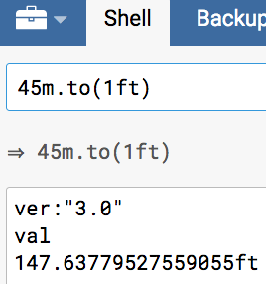
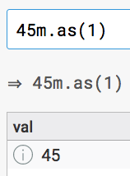
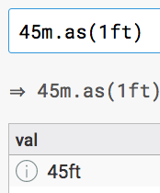
Functions: to vs as
to converts
as changes without converting
Add, remove, or change units
Must have number before new unit
Both can use any number in () and won’t affect result, but standard convention is to use 1

Slide 75
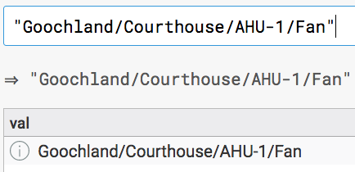
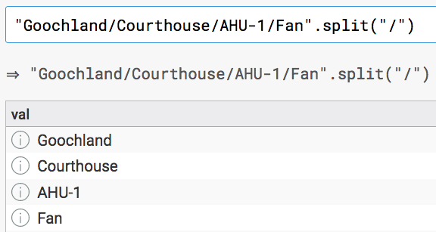
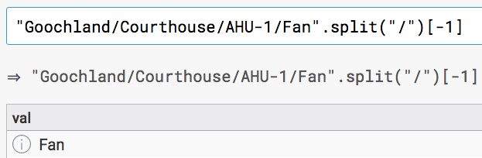
Split Function
1)
The split() function takes a string and a delimiter
It allows you to turn a single string into multiple records
It furthermore allows you to handpick a piece of the original string
Used a lot when importing from csv files and sql databases
2)
3)

Slide 76
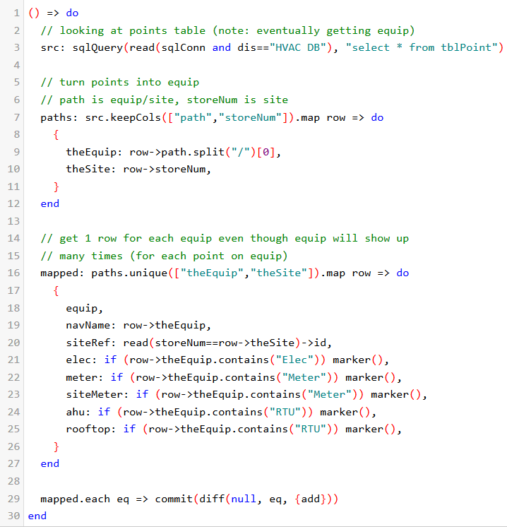
Adding a Marker Tag Based on a Row
The marker() function turns a cell into an is value which is like a true in Boolean
See the example for how to use the marker() function:
Also note, how we use contains() for our wildcard in SkySpark
Note unique() is like sql Distinct

Slide 77
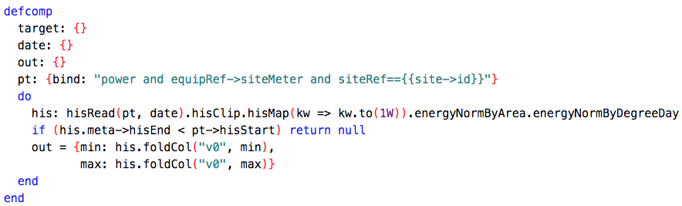
The return Function
This function will short circuit the innermost function you are in and jump to the next innermost function or next loop iteration
For functions like the one below that are not nested, it will simply return what is described and jump out of the function
Use return to temporarily check a result inside a function
Needs quotes in a filter because of this function: read(“return” and temp)

Slide 78

Importing Fundamentals:
The Java Virtual Machine restricts access to only the io/ directory for security reasons
First step: open the file and learn your schema/data!
When you do an import, the data comes in as a grid most of the time:
ioReadCsv(`io/sites.csv`)
ioReadLines(`io/sites.txt`)
ioReadTrio(`io/func.trio`)
ioReadZinc(`io/sites.zinc`)
ioReadJsonGrid(`io/data.json`)
xmlRead(`io/points.xml`)
sqlQuery(read(sqlConn), "select * from tblSite")
read(haystackConn).haystackReadAll(point and siteRef and equipRef)
Exception:
ioReadStr(`io/sites.csv`)
ioReadJson(`io/points.json`)
Importing

Slide 79
Committing Records and Writing History

Slide 80

Synching Histories without a Connector
Here is some example code:
Note that we use hisWrite() to write history to a point, but we use commits to write everything else to the database
An initial file import starts the history and future history imports are scheduled in the Job tab of the Tools app

Slide 81
Making Changes to the Folio Database How commits work part 1
The functions each and map work the same here, but map will show you your results while each will not
When thinking about commits, think about CRUD operations (except for read)
Add New Record:
commit(diff(null, {dis: "building", site, area: 6000ft²}, {add}))
{y:2,z:3}.toGrid.each row => commit(diff(null, row, {add}))
These grids could be the result of an import script such as ioRead...
{y:2,z:3}.toGrid.map row => commit(diff(null, row, {add}))
Updates:
readAll(kW).each pt => commit(diff(pt,{-kW, power}))
How to add or remove tags from records or groups of records
readAll(kWh).map pt => commit(diff(pt,{-kWh, energy}))

Slide 82

How do commits work pt 2?
Removes (entire record or group of records):
readAll(power).each pt => commit(diff(pt, null, {remove}))
readAll(meter).map eq => commit(diff(eq, null, {remove}))
If operating on many records, do you want to use map() or each()?

Slide 83
Import Example
Do this in the code app
Exercise: Can you add occStart and occEnd from the csv file?
How will you parse a string into a time?
Can you turn area into a number? It is currently a string. How would you programmatically add units (ft²)?
How do you show that this is a site (look at sites in the Builder app of the Demo DB)?
For Fun: What about time zone (tz) using the geoTz() function?
() => do
csv: ioReadCsv(`io/import-sites.csv`)
grid: csv.map row => do
{
dis: row->dis,
area: row->area,
geoAddr: row->street,
geoCity: row->city,
geoState: row->state,
}
end
grid//.each tags => commit(diff(null, tags, {add}))
end

Slide 84
Import Exercise
Import the file `io/import-points.csv`
How will you bring in a csv file?
Use your code from the last exercise as a starting point
Make sure you get a navName
Don’t worry about EquipRef and SiteRef right now
What extra tags are mandatory: such as point, his, and kind (look at the points in the Demo DB’s Builder app)?
How will you get the units?
More Thorough Credit: Some tags can you add based on project-haystack.org: sensor, cmd, air, temp, power, energy. Any others?

Slide 85
Creating Spark Rules (sparkRule tag)

Slide 86

Components The Building Blocks of Rules
Component-based software engineering works well with the programming principle of modularity
Just take a rule algorithm and put it inside of the component syntax
In axon
Do not have parameters or a return value
Inputs and outputs defined in cells
Component

Slide 87
Components The Building Blocks of Rules
Keywords
cells – think of these as variables
target (cell) – what physical thing the rule will run on
date (cell) – denotes that the rule will process code over time
out (cell) – what the rule will return
bind – take a filterString and make a cell reference its resultant record (like read)
bindAll – take a filterString and make a cell reference its resultant records (like readAll)
bindTuning – pass a value to a cell
limit: {bindTuning: "limit", defVal:400kW}
cell name
ruleTuning name
defVal – give a cell a default value
ro – indicate that a cell is read-only such as out / output

Slide 88

Components The Building Blocks of Rules
Must have defcomp..end
Cell/variable definitions follow the defcomp keyword
target: {}
date: {}
out: {ro}
Any records needed in the function (called pt in example)
Must have do..end after cell/variable definitions that sets the out variable
Advantages
Clearly define inputs and outputs at top of function (how many of us learned to code)
Components resolve quicker than other functions
Enables easy debugging in Rule => Debug => Comps => rule_name => target_name
Binds are automatically unchecked and return does not need quotes
curRules must be done this way
Examples to follow in the form of sparkRules and kpiRules

Slide 89

sparkRule Functions
For what patterns would you like SkySpark to look?

Slide 90
sparkRule Fundamentals
sparkRules run on targets which come from the SEP model, meaning they should run on sites, equip, or points with the majority being written to run at the equip level (allows you to easily compare point histories)
In the code, sparkRules need to eventually drop down to the point level and look at history data
sparkRules need to take a ts, val grid and convert them to time and durations for the spark engine - ts, dur grid
The sparkRule engine always runs sparkRules at the daily level even when a larger time is selected (that is why it is important not to use hisClip and to have those boundary conditions)
The Tools app can run sparkRules at whatever duration you select
The Spark app and the Tools app can show different results when counts are used

Slide 91
sparkRule Example
defcomp
target: {}
date: {}
out: {ro}
pt1: {bind: "cool and equipRef=={{target->id}}"}
pt2: {bind: "temp and return and equipRef=={{target->id}}"}
do
co: pt1.hisRead(date)
.hisFindPeriods(x => x)
tmp: pt2.hisRead(date)
.hisFindPeriods(x => x < 80)
out = hisPeriodIntersection([co, tmp])
end
end

Slide 92
Reviewing the kwTooHigh function in the Demo Project
defcomp
target: {}
date: {}
out: {ro}
powerPt: {bind: "power and equipRef=={{target->id}}"}
limit: {bindTuning: "limit", defVal:400kW}
do
out = hisRead(powerPt, date).hisFindPeriods(kw => kw > limit)
end
end

Slide 93


Testing sparkRules
Testing: ruleTest(kwTooHigh, read(equip), pastWeek)
Lots of good information
Use [2]->val to get results grid
Remember that even though you can test sparkRules over a dateSpan, sparkRules are run a day at a time

Slide 94

More sparkRule Fundamentals
Tags needed to make a function rule-ready
dis – this is the human-readable pretty name of the function and will become that for the sparkRule
help – this tells what the sparkRule will do and can include step-by-step instructions
ruleOn – indicates what the target of the sparkRule will be (must be valid filter)
ruleType: sparkRule – yields the sparkRule marker tag
You can hit the edit button in the Code app to add / modify these tags

Slide 95

Still More sparkRule Fundamentals
Remember the exercise from Module 2 that made a sparkRule record that references a rule-ready func
sparkRules are a reference to a func
Allows multiple sparkRules to reference one func
The following tags are added automatically when a rule-ready function is properly set up in the Rule app
dis – this is the human-readable pretty name of the sparkRule
rule – all rules have this tag
sparkRule – indicates what kind of rule this is
ruleOn – indicates what the target of the sparkRule will be (must be valid filter)
help – this tells what the sparkRule will do and can include step-by-step instructions
Navigate to the Code App in the Demo project and find kwTooHigh and hit Edit. Note it has these tags. Now, go to the Rule app and Local tab to see all rules including sparkRules.

Slide 96

sparkRule Exercise
Write a sparkRule func in the Code app that runs at the equip level and sparks any time a zone air temp sensor goes above 70°F. sparkRules run automatically on all relevant points based on the ruleOn tag and your tagging.
Extra credit: it only sparks when this pattern happens for more than 30min
What will the bind look like?
How can history data be converted to a duration?
Add dis, help, ruleType: sparkRule, and ruleOn: ahu tags
Set this up in the Rule app (don’t forget refresh)
Look for results in the Spark app
Exercise
Always build and test functions step-by-step

Slide 97
Creating KPI Rules (kpiRule tag)

Slide 98

kpiRule Functions
For comparing things against their peers to identify high performers and not so high performers

Slide 99
kpiRules (Key Performance Indicators)
kpiRules run on a target and a date. Targets come from SEP (site, equip, or point) with most kpiRules running at the site level. In the code, they then drop down to points and their histories.
kpiRules must return a dictionary
Note the hisClip()
kpiRule column names must be min and max or sum or delta or avg which affect how the data will rollup and plot. Other names will not work. Also, each cell in the KPI app can only show 1 or 2 values at a time.
defcomp
target: {}
date: {}
out: {ro}
pt: {bind: "energy and equipRef->siteMeter and siteRef=={{target->id}}"}
do
his: hisRead(pt, date).hisClip()
out = {sum: his.foldCol("v0", sum)}
end
end
Note that kpiRules must be recomputed after changes are made.

Slide 100
Reviewing the Custom kpiRule in the Demo Project
defcomp
target: {}
date: {}
out: {ro}
kw: {bind: "power and equipRef->siteMeter and siteRef=={{target->id}}"}
do
if (kw == null) return null
his: hisRead(kw, date).hisClip.hisMap(kw => kw.to(1W)).energyNormByArea
if (his.isEmpty or his.meta["hisEnd"] < kw["hisStart"] or his.missing("v0")) return null
out = {min: his.foldCol("v0", min), max: his.foldCol("v0", max)}
end
end

Slide 101


Testing kpiRules
Testing: ruleTest(kpiWattsNorm, read(site), 2020-02)
Lots of good information
Use [2]->val to get results grid
kpiRules run on whatever dateSpan you select

Slide 102

kpiRule Set up
Tags needed to make a function rule-ready
dis – this is the human-readable pretty name of the function and will become that for the kpiRule
help – this tells what the kpiRule will do and can include step-by-step instructions
ruleOn – indicates what the target of the kpiRule will be (must be valid filter)
ruleType: kpiRule – yields the kpiRule marker tag
Click the edit button in the Code app to add / modify these tags

Slide 103

More kpiRule Set up
Remember the exercise from Module 2 that made a kpiRule record that references a rule-ready func
kpiRules are a reference to a func
Allows multiple kpiRules to reference one func
The following tags are added automatically when a rule-ready function is properly set up in the Rule app
dis – this is the human-readable pretty name of the kpiRule
rule – all rules have this tag
kpiRule – indicates what kind of rule this is
ruleOn – indicates what the target of the kpiRule will be (must be valid filter)
help – this tells what the kpiRule will do and can include step-by-step instructions
Navigate to the Code App in the Demo project and find kpiWattsNorm and click on Edit. Note it has these tags. Now, go to the Rule app and Local tab again to see all rules including kpiRules.

Slide 104
kpiRule Exercise
Write a kpiRule that calculates the sum of a water meter’s usage
Note that the demo only has one water meter in Headquarters/Utility
What query would find the only point on a water meter?
Might there be any unique tags?
Use the Builder app for help
What will the read look like?
What needs to be returned?
Have it run on the site level
Extra credit: have the result normalized per area
(gal/ft²)
Add dis, help, ruleType: kpiRule, and ruleOn: site tags
Set this up in the Rule app (after a refresh)
Look for results in the KPI app

Slide 105
Debugging Topics

Slide 106

Debugging Topics
Give to SkyFoundry support when troubleshooting performance issues
Real-Time Diagnostics Tab in Debug App (pictured below)
Lint Screen
Error messages (shown earlier)
Return command (shown earlier)
Echo command
Dump command
Look for errors in
the Terminal/cmd
prompt at SkySpark startup

Slide 107

Diagnostics with Code
Run diags() in Tools:

Slide 108


The Lint Screen
Go to The Debug App->Lint tab
Tagging errors and warnings are listed
Check periodically
Also note the lint() command

Slide 109




Echo Command
Use the echo() command when debugging
to see what is being returned as a standard out
It is great for seeing intermediate loop results

Slide 110


Dump command:
Use the dump() command:
Return, echo, and dump all show up in Tools if they are the last piece of code executed
Specifically to return entire grid
It can also mimic echo() functionality

Slide 111

Try/Catch and Throw
Use try…catch to handle exceptions that occur in a block of code. Maybe you want SkySpark to send out an email or give some information?
try
doStuff()
catch
handleStuff() [Maybe log error]
Return the error dictionary for debugging purposes.
try
makeError()
catch(e)
e
You can force an exception with throw()
So you can go from error space to normal space or normal space to error space depending on what you are trying to do

Slide 112

Cleaning up a Display Name
Equip and points have a navName so that their full names can be re-calculated when they are moved or their parents (site or equip) are renamed. Everything else has a dis (sites, functions, and so on).
The id tag is masked by default in SkySpark with a more friendly, human-readable name
This friendly name is what you will see as the record’s name in SkySpark apps
You can programmatically set this with the disMacro tag (equip and points). Note the $ in this picture which makes the text a kind of variable. Without the $, you get a string literal that will show up.
The dis() function can be used to always grab the correct display name in whatever form it takes and is preferred to read(point)->navName. (Use read(point).dis).

Slide 113
Sending Emails from SkySpark

Slide 114

Emailing a List of Favorite Favorites
You can set up Jobs to automatically push an email with a list of Favorite links – for example a daily set of summary Reports (code to follow):
4 Steps
Set up email service in the Settings App
Define siteURI field in Exts App
Create a function
Set up a Job to run on a scheduled basis

Slide 115



Emailing a List of Favorite Favorites
Set up email

Slide 116

Emailing links to Favorites Create a function
Create a function called emailReports with the code shown below after adding the siteUri to the projMeta:
() => do sendTo: ["adam@skyfoundry.com"]
body: "<html><body>\n<p>Your daily SkySpark reports:</p><ul>\n"
readAll(fav).each r => do
uri: uiLinkAbs({view: r->viewLink->view, state: r->viewLink->state})
body = body + "<li><a href='" + uri + "'>" + r.dis
end
body = body + "</ul><body></html>\n"
emailSend(sendTo, "SkySpark Reports", body)
end

Slide 117

Emailing links of Favorites: Setting up a Job
Go to the Tools app => Job tab and add a Job to run the emailReports function:
Set it up to run on a scheduled basis
Once it is created, run the Job to test the email configuration

Slide 118
Emailing Favorites Summary Steps
Enable the Email extension
Configure SMTP
Build fav(s)
Use the emailSend() command in a function
Schedule a Job with the emailSend() function
For more info: https://www.skyfoundry.com/doc/docFresco/Export#email

Slide 119

Using the emailSend() Command pt 1 Setting Up Favorites
Setting Up Favorites
In this example, two favorites were created and given distinct marker tags
One has fav1 and the other has fav2
My favorites both use relative dates of today. That way they will always show today’s data.

Slide 120
Using the emailSend() Command pt 2 The Command
Parameters
// simple "to" email address
emailSend("a@acme.com", "subject", "body")
// list of "to" email addresses
emailSend(["a@acme.com", "b@acme.com"] "subject", "body")
// to, cc, and bcc recipients
emailSend({to:"a@acme.com", cc:["b@acme.com", "c@acme.com"]},"subject", "body")
The fourth parameter is an optional set of attachments. See emailSend() for more details on the types that can be used in the attachment list.
// send single attachment
emailSend("a@acme.com", "subject", "body", `io/report.pdf`)
// send a list of attachments.
favId: @p:demo:r:22b69382-6cecf405
favDict: read(fav and dis== "Favorite 1")
compound: [fandoc("This is a compound report."), read(energy).hisRead(yesterday)]
emailSend("a@acme.com", "subject", "body", [`io/data.xml`, favId, favDict, compound])

Slide 121



Using the emailSend() Command pt 3 The Example
Example:
If using a gmail account, generate an app password for SkySpark (Google has extra security)
1)
2)
Note that my reports are automatically turned into PDFs on-the-fly

Slide 122
Helpful Topics to Review after Class

Slide 123



Moving Funcs between Projs
Tag functions that will be exported
Write a trio file
Move the trio file between io folders
Import the trio file into the new database
1)
2)
4)
3)
copy skyspark-ver/var/proj/demo/io/customFuncs.trio
to skyspark-ver/var/proj/training/io/customFuncs.trio

Slide 124
New Axon Functions to Support Distributed Systems
The new Xquery commands allow full control of when to query a local project or external projects
In the same way that parenthesis are wrapped around code, wrap xq() … .xqExecute() around code that will make queries across multiple projects in distributed systems. All commands in between will start with an xq and follow standard lower camelCase rules.
Simple Example to read all sites across a cluster: xq().xqReadAll(site).xqExecute()
XQueries force execution to occur in the local node(s) and then results are passed up to the user’s browser
Force read in one project: xq().xqProjs([“demo”]).xqReadAll(power).xqHisRead(lastWeek).xqExecute()
Force code to run on remote machines: xq().xqEval(“readAll(site)”).xqExecute()
This will replace the need for haystack connectors when performing inter-project communication for many users

Slide 125


Using Stackhub
https://stackhub.org/
The following functions can be downloaded via stackhub
People in the SkySpark community can upload pods to Stackhub
Then, others can download those pods
Go to the Host level’s Host App’s Install Manager and click Install
Then, do a search for nothing and all available add-ons will show up
One of the current available pods has the calculus
functions
Search for “”

Slide 126

Certification Test Information

Slide 127


SkySpark® Essentials Certification
Upon completion of the course, each student will be sent unique credentials to access and take the test
Access from desktop, tablet or mobile and you can pause, save and resume as time allows
The test is meant to be completed individually

Slide 128

SkySpark® Essentials Certification
Format - Two Sections
General Knowledge questions
Exercises completed working with a SkySpark project downloaded from SkyFoundry Secure site
Certificate generated on successful completion and ready to be printed / downloaded
Email with summary information and link to certificate

Slide 129
SkySpark® Essentials Certification
FREE if successfully completed within 60 days of taking the SkySpark Essentials course
Outside of the 60-day period after training, the cost will be $100 net per individual
Credit Card / PayPal only for certification test

Slide 130
Additional Topics
SparkRules Readily Available
https://skyfoundry.com/file/369/SparkRules-Readily-Available-Training.pptx
Getting SparkRule Notifications
https://skyfoundry.com/file/326/SkySpark-30-Emailing-Sparks.pptx
Debugging SkySpark System Performance
https://skyfoundry.com/doc/docAppNotes/DebuggingSystemPerformance

Slide 131

Final Message
Do not copy or delete any SkySpark files while SkySpark is running
Windows (especially) locks random files, so a copy will be incomplete
Stop SkySpark before performing external io operations. The io directory is okay as it is only used when called upon.

Slide 132
End of Module 5

